Slide 1
Improved Weights for Estimating the Meta-analytic Mean
Michael Brannick
Sean Potter
Notes:
. As you can probably guess from this title, this is a talk about meta-analytic methods, and specifically it’s about our investigation of the performance of several well-methods methods when dealing with the skewed sample size distributions we commonly encounter with real meta-analytic data. I promise you this won’t be a talk just filled with formulas, some will be presented but will help to highlight conceptual differences between methods. And for our newer students, I hope this talk is informative about meta-analysis in general.

Slide 2
Outline
Comparison of Meta-Analytic Methods
Schmidt & Hunter
Hedges
New “Morris” method
Design of Simulation Study
Results
Discussion

Slide 3
Meta-Analytic Mean Estimate
Mean effect size (r) of interest to I-O researchers
Mean estimate has some degree of uncertainty
Common practice to compute 95% confidence interval (CI)
In a perfect world…
Our estimated $\overline{r}$ would be close to true value $\overline{ρ}$
AND
Our 95% CI at least contains $\overline{ρ}$ 95% of time
Notes:
The focus of our study involved seeing how well different methods were at estimating the meta-analytic mean estimate. Specifically, the mean effect size we used was the correlation coefficient, r, because that is commonly used among I-O researchers. Often use mean estimate as main interpretation of results (what’s the average effect? The value studied for comps)
It’d be nice if our estimate was actually the population’s value, but it’s estimated with some degree of uncertainty.
The mean estimate is obtained by assigning studies weights and then aggregating them together. Different methods used different weighing schemes.

Slide 4
Schmidt & Hunter Method*
Most widely known to I-O researchers
Weighs studies by sample size (N_{i})
Doesn’t include random-effects variance (REVC) in weights
”True” variability across studies
May be problematic when distribution of N is skewed
Don’t Include REVC
Include REVC
Small N study
Small N study
Large N study
Large N study
*Schmidt, F. L., & Hunter, J. E. (2015). Methods of meta-analysis (3rd ed.). Los Angeles, CA: Sage.
Notes:
Schmidt & Hunter pioneered a method to aggregate results across studies to show that oftentimes mixed results between studies were the result of sampling error.
The key concept to remember about Schmidt & Hunter is that assign weights based on sample size. Larger studies are seen as more precise and will be closer to the true effect so they are given more consideration.

Slide 5
Should We Include REVC?
Schmidt and Hunter argue REVC often poorly estimated*
Dependent on number of studies (k), k is often small
Good empirical justification to still include REVC
Unit weights performed better than Schmidt-Hunter when:
REVC large
Sample distribution based on real studies**
Methods by Hedges and by Morris include REVC
Hedges use r to z, which problematic
Morris doesn’t use r to z
**Brannick, M. T., Yang, L., & Cafri, G. (2011). Comparison of weights for meta-analysis of r and d under realistic conditions. Organizational Research Methods, 14, 587-607.
*Schmidt, F. L., & Hunter, J. E. (2015). Methods of meta-analysis (3rd ed.). Los Angeles, CA: Sage.

Slide 6
Objectives
Overall mean – bias, coverage, RMSE (efficiency)
Compare Morris to Hedges and Schmidt-Hunter.
Less bias than Hedges
Better coverage than Schmidt-Hunter
Notes:
Due to using the weighted mean r (because we are not using r-to-z) to calculate sampling error (like SnH), we expect Morris to have less positive bias than Hedges.
Due to using random-effects variance in the weights (like Hedges), we expect Morris to have better coverage than SnH.
Closer to unit weights, because the extreme values of rho[i] don’t get weighted as much and get pulled closer to the overall mean.
From the paper:
“Thus, like the Schmidt-Hunter analysis (but unlike Hedges), the Morris estimator uses the weighted mean r in the calculation of the within-study sampling error. Like the Hedges analysis (but unlike Schmidt-Hunter) the Morris estimator uses the random-effects variance in the weights to estimate the summary (meta-analytic mean) effect.”

Slide 7
Methods
Parameter | Very small | Small | Medium | Large
ρ | - | 0.14 | 0.26 | 0.42
σ_{ρ} | - | 0.08 | 0.13 | 0.18
k | 5 | 10 | 30 | 100
Paterson, T. A., Harms, P. D., Steel, P., & Crede, M. (2016). An assessment of the magnitude of effect sizes: Evidence from 30 years of meta-analysis in management. Journal of Leadership & Organizational Studies, 23(1), 66-81. doi:DOI: 10.1177/1548051815614321
Notes:
Paterson (2016): 250 meta-analyses in management
Percentiles for rho : 25th = 0.14; 50th = 0.26; 90th = 0.42
Similarly, for sigma rho, 0.08 was on the smaller end, 0.13 was around the middle, and 0.18 was on the larger end.
For Sigma Rho, we also included a condition for 0 (i.e. no random effect) to simulate just a fixed effect.

Slide 8
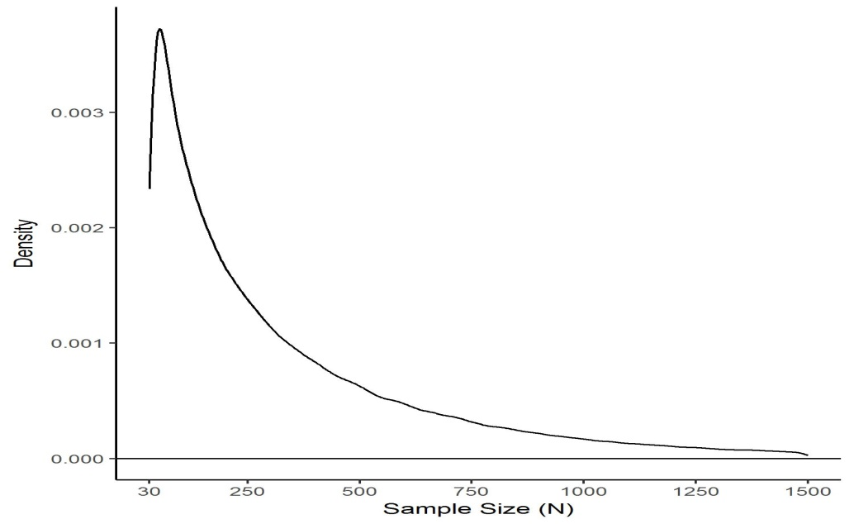
Methods
N_{i}
Sample sizes tend to be positively skewed
Gamma distribution with shape = 0.57, Scale = 500
Minimum set to 30
Mean = 360, median = 224, SD = 395, skewness = 2.5
Notes:
Meta-analyses tend to have positively skewed sample sizes for the studies that are reviewed (Sanchez-Meca & Marin-Martinez, 2008).
The Gamma produces positive values from 0 to positive infinity.
Manipulating shape and scale parameters allow us to set skews relatively easily.
Because non-integers are possible, we rounded all values up to the nearest whole number.

Slide 9
Methods – Quick Review
Pick a distribution for $ρ$ (normal vs. skewed)
Pick a value for mean$\overline{ρ}$
Pick a value for σ_{ρ}
Pick a value for k
Generate sample sizes
Generate rxx and ryy for each study (Schmidt & Le)
Generate k observed correlations
Meta-analyze them
Repeat generation and analysis 10,000 times.
Notes:
For skewed distributions, there are 36 possible conditions / combinations of parameters.
For normal, there are 36 possible conditions.
For 0, there are 12 possible conditions.
Total of 120 possible conditions.

Slide 10


Outcomes For Each Method
$$\frac{\sum{(\hat{ρ}−\overline{ρ})}}{Total Replications}$$
Bias
RMSE
Coverage
$$\sqrt{\frac{\sum{{(\hat{ρ}−\overline{ρ})}^{2}}}{Total Replications}}$$
$$\frac{\begin{aligned} \\ 95\% CI Includes \overline{ρ}\end{aligned}}{Total Replications}$$

Slide 11
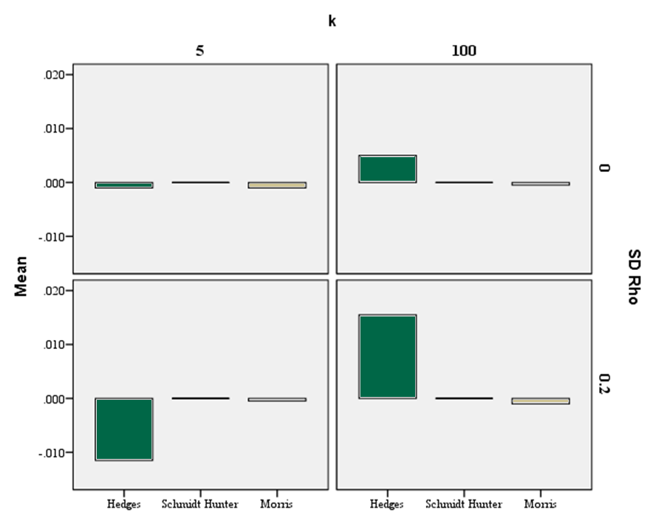
Bias Results
Notes:
I am only showing the extreme end results for each of these methods. The actual value of rho didn’t appear to have much difference.
Per expectations, hedges shows increasing amount of positive bias as sample size increases
Generally, bias was mostly neglible

Slide 12
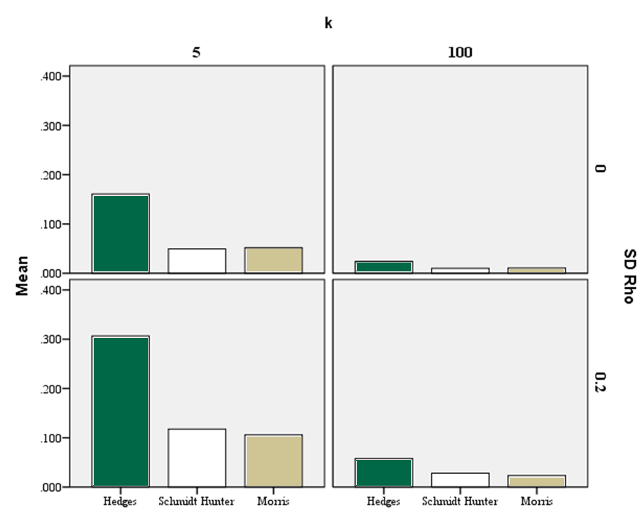
RMSE Results
Notes:
Suggests that Hedges has fairly poor precision in estimating the mean compared to Schmidt-Hunter and Morris, particularly when sample size is small.

Slide 13
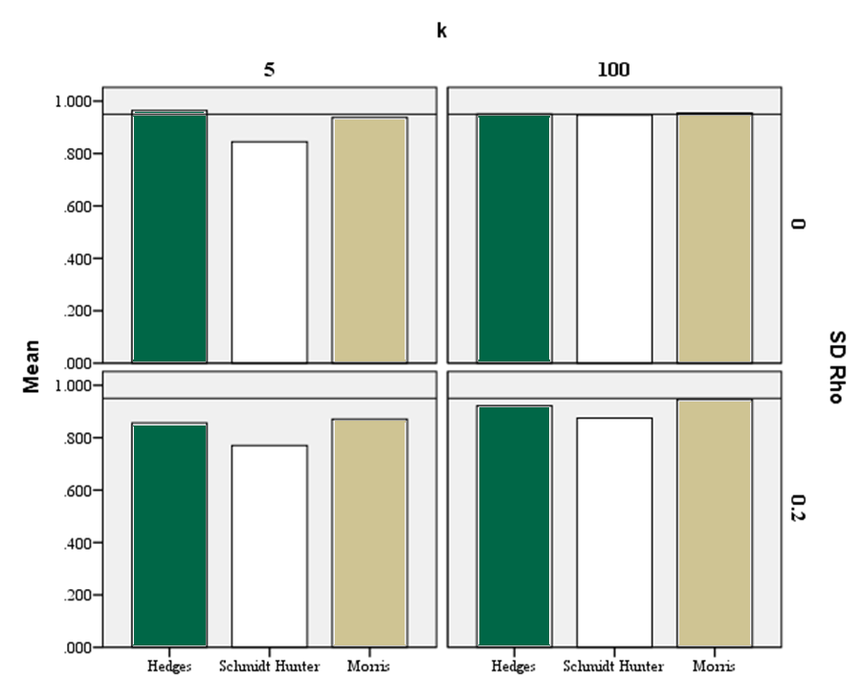
Coverage Results
Notes:
Schmidt-Hunter shows way below the nominal .95 rate when REVC present, increasing number of studies didn’t help that much

Slide 14
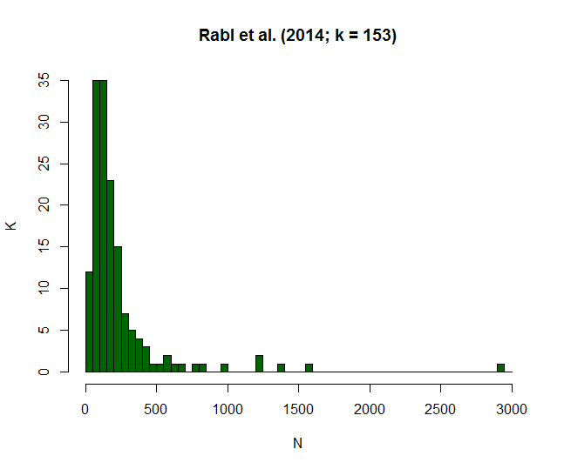
What Do Sample Distributions Look Like?
Real world samples often skewed
Larger N studies may be sampled from unrepresentative $ρ_{i}$
Rabl, T., Jayasinghe, M., Gerhart, B., & Kühlmann, T. M. (2014). A meta-analysis of country differences in the high-performance work system–business performance relationship: The roles of national culture and managerial discretion. Journal of Applied Psychology, 99(6), 1011.

Slide 15
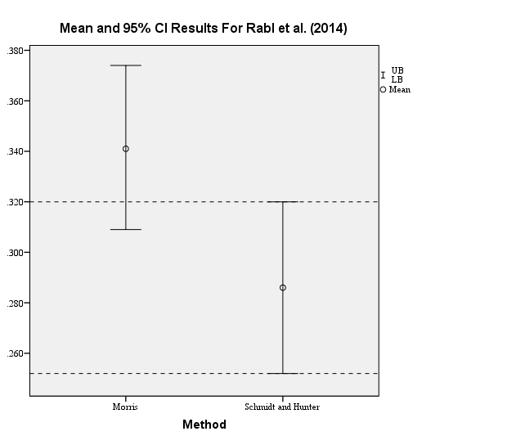
Comparison of Real Meta-Analytic Results
*Rabl, T., Jayasinghe, M., Gerhart, B., & Kühlmann, T. M. (2014). A meta-analysis of country differences in the high-performance work system–business performance relationship: The roles of national culture and managerial discretion. Journal of Applied Psychology, 99(6), 1011.
Notes:
Examining relationship between high-performance work systems and business performance
K = 156
N = 35,767
Results can be obtained using new Schmidt and Hunter meta-analysis function in R.
Corrected for reliability on x and y only

Slide 16
Discussion
Morris appears to be viable estimator of $\overline{ρ}$
Lower bias than Hedges
Better coverage than Schmidt-Hunter
RMSE values as good or better than other estimators
Morris easily implemented with current software
R code on Github (website has url)

Slide 17
Limitations and Future Directions
Used limited set of parameter values
Other parameter choices may give different results
Didn’t include other artifacts (range restriction)
Don’t know their influence on bias, efficiency, or coverage
Should continue to compare methods on other estimates
Credibility interval

